Slide 1
Basketball and Machine Learning
A project presented by the Monstars

Slide 2
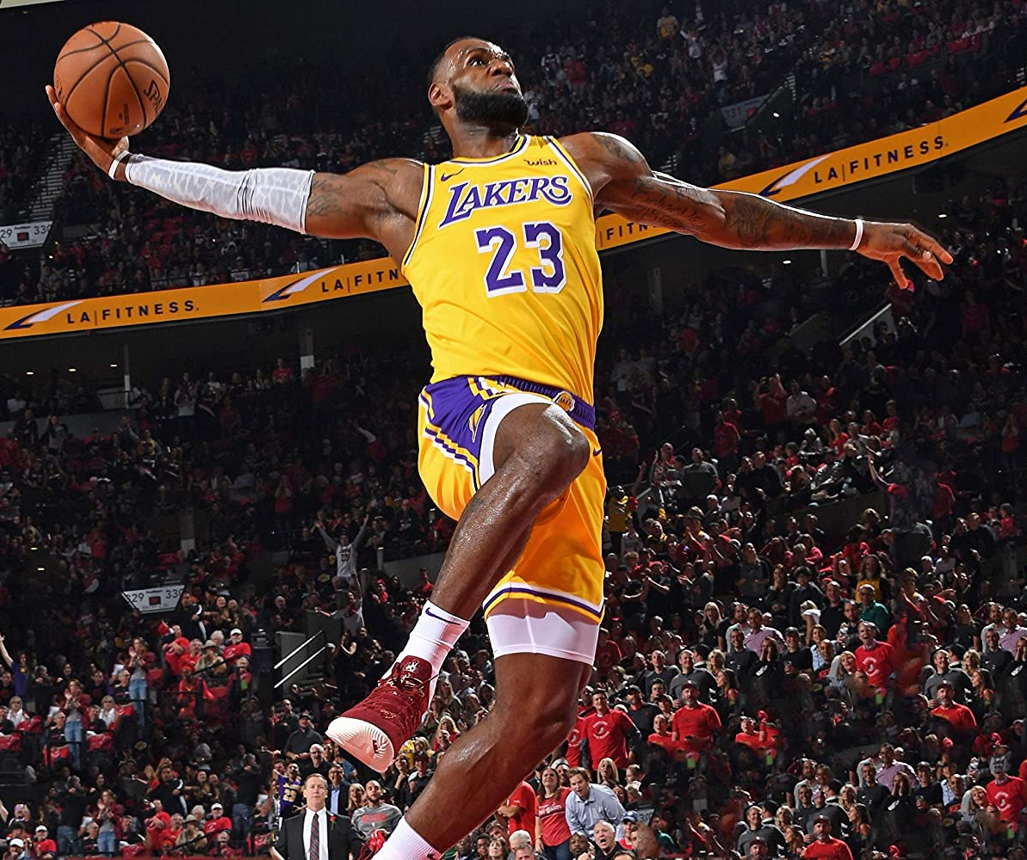
Project Mission
The Monstars hope to use various basketball datasets and machine learning models to make meaningful insights and predictions.
“Once he had that little [bit], he wanted more, If the greatest player of his generation is looking for an edge, I think other people would be wise to follow.” – Shane Battier

Slide 3
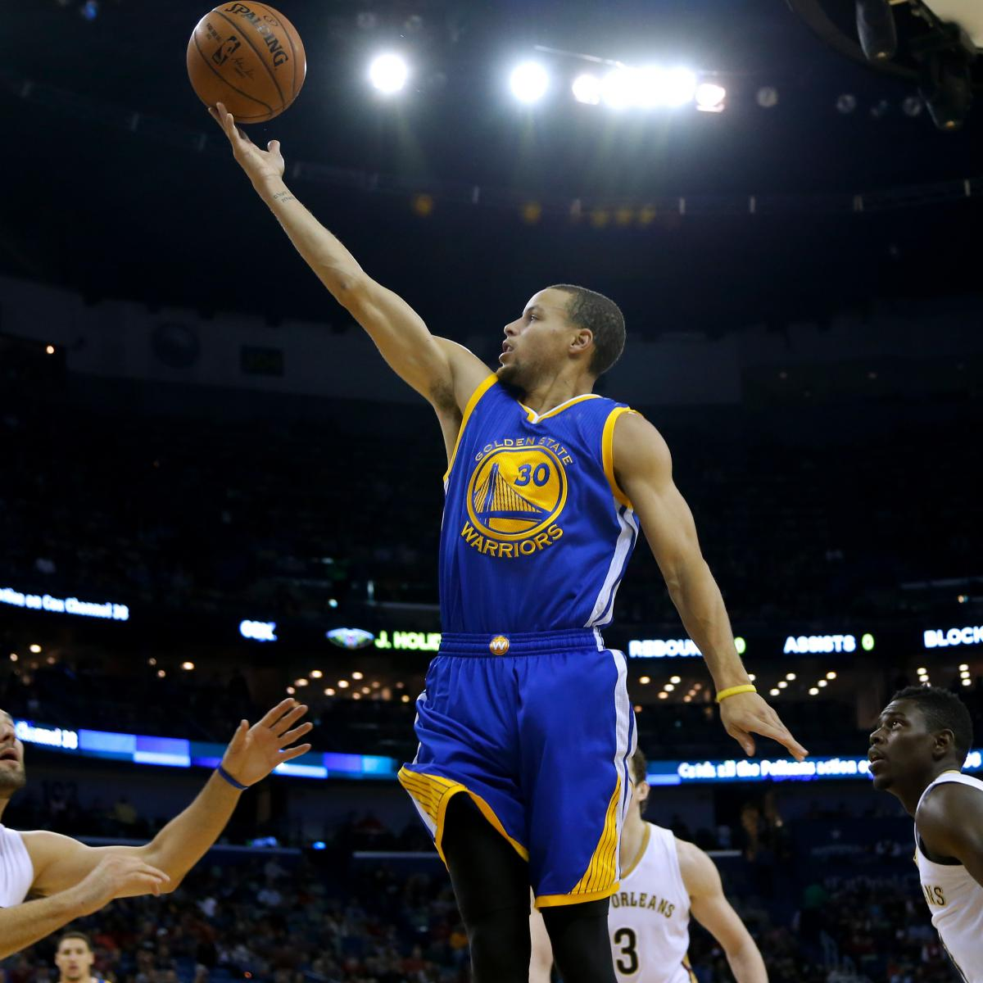
Our Plan and Sources
We each developed our own hypothesis of how to apply machine learning to basketball statistics and developed models to test those hypotheses.
We investigated if we could use a single player to determine the outcome, predicting winning factors based on play, predicting home team game result based on previous games, and fan sentiment vs team performance.
We also started a web app to display our findings.
Sources:
https://www.basketball-reference.com/
https://github.com/vishaalagartha/basketball_reference_scraper

Slide 4
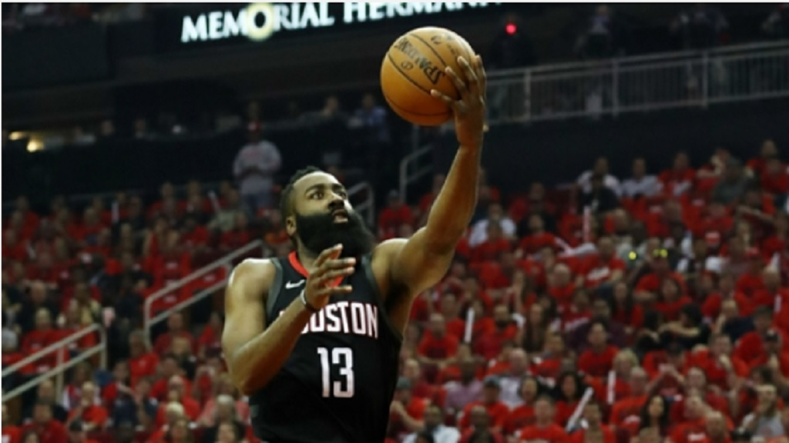
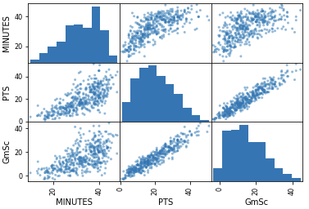
A Look Into James Harden
Can we predict a team win by looking at a single player?
Here is a visualization of Hardens first six years as a player.

Slide 5
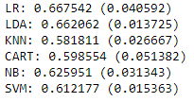
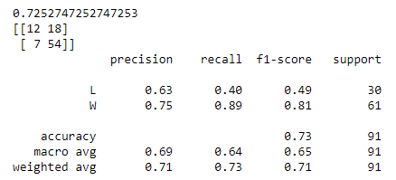
Using Hardens Stats to Predict Wins or Loses
Using a spot check algorithm, we concluded that a Linear Discrimination Analysis (“LDA”) would be the best model give accurate findings.
After running the LDA, we received a 73% accuracy of Wins and Loses based on Hardens Minutes, Points, and Game Score.
These model predictions could be expanded on and used on future games to help determine the outcome of the game depending on how Harden is performing.

Slide 6
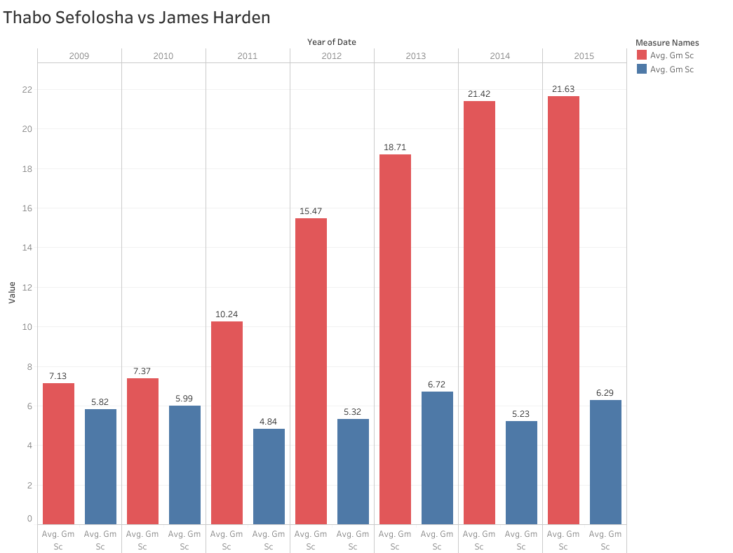
A Quick Comparison of Players Using Tableau
A quick glance at James Harden compared to Thabo Sefolosha, the player that started over him.
As we can see, Harden was a better player and was getting better, while Sefolosha stayed relatively the same.

Slide 7
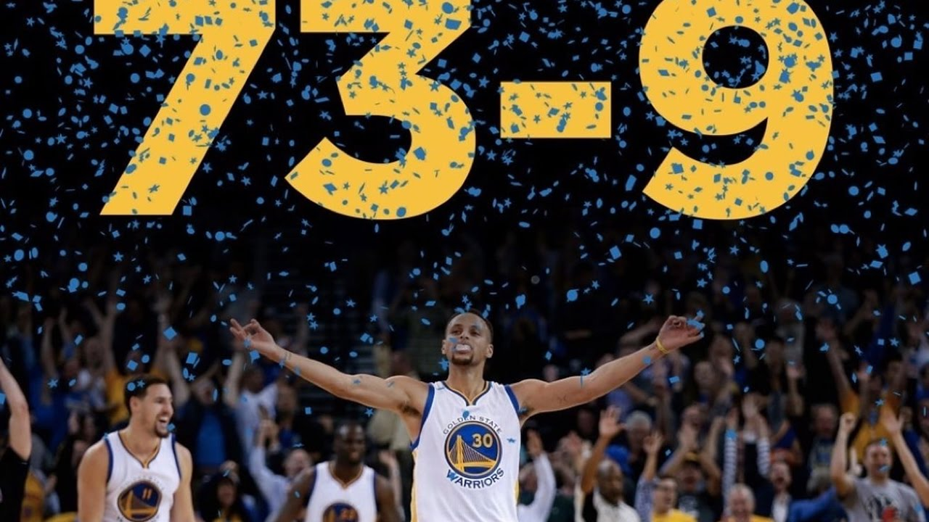
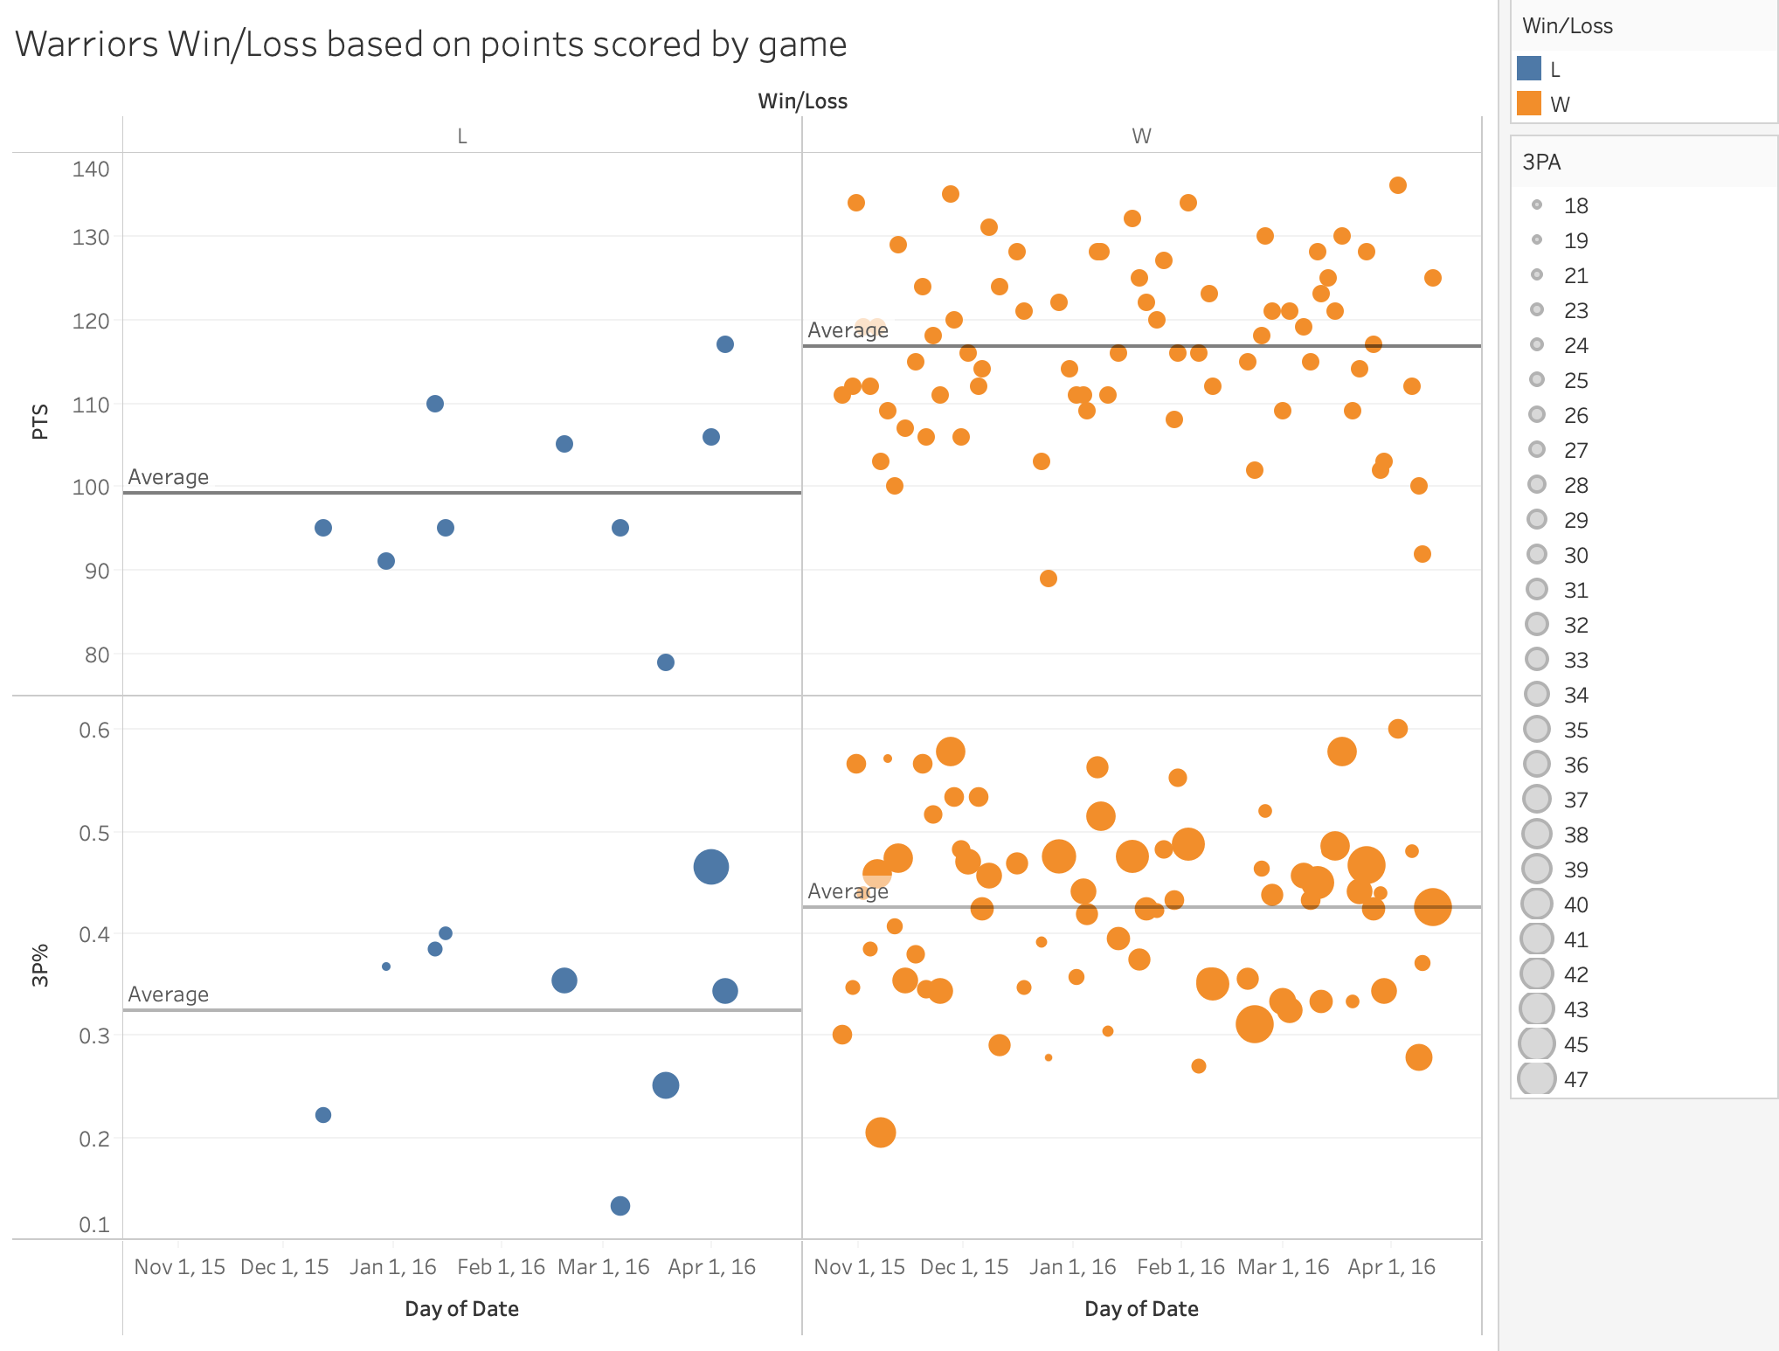
Analyzing a Teams Play to Predict Winning Factors
What are some common factors that lead to a winning team? Can we use these characteristics to predict the result of a game?

Slide 8
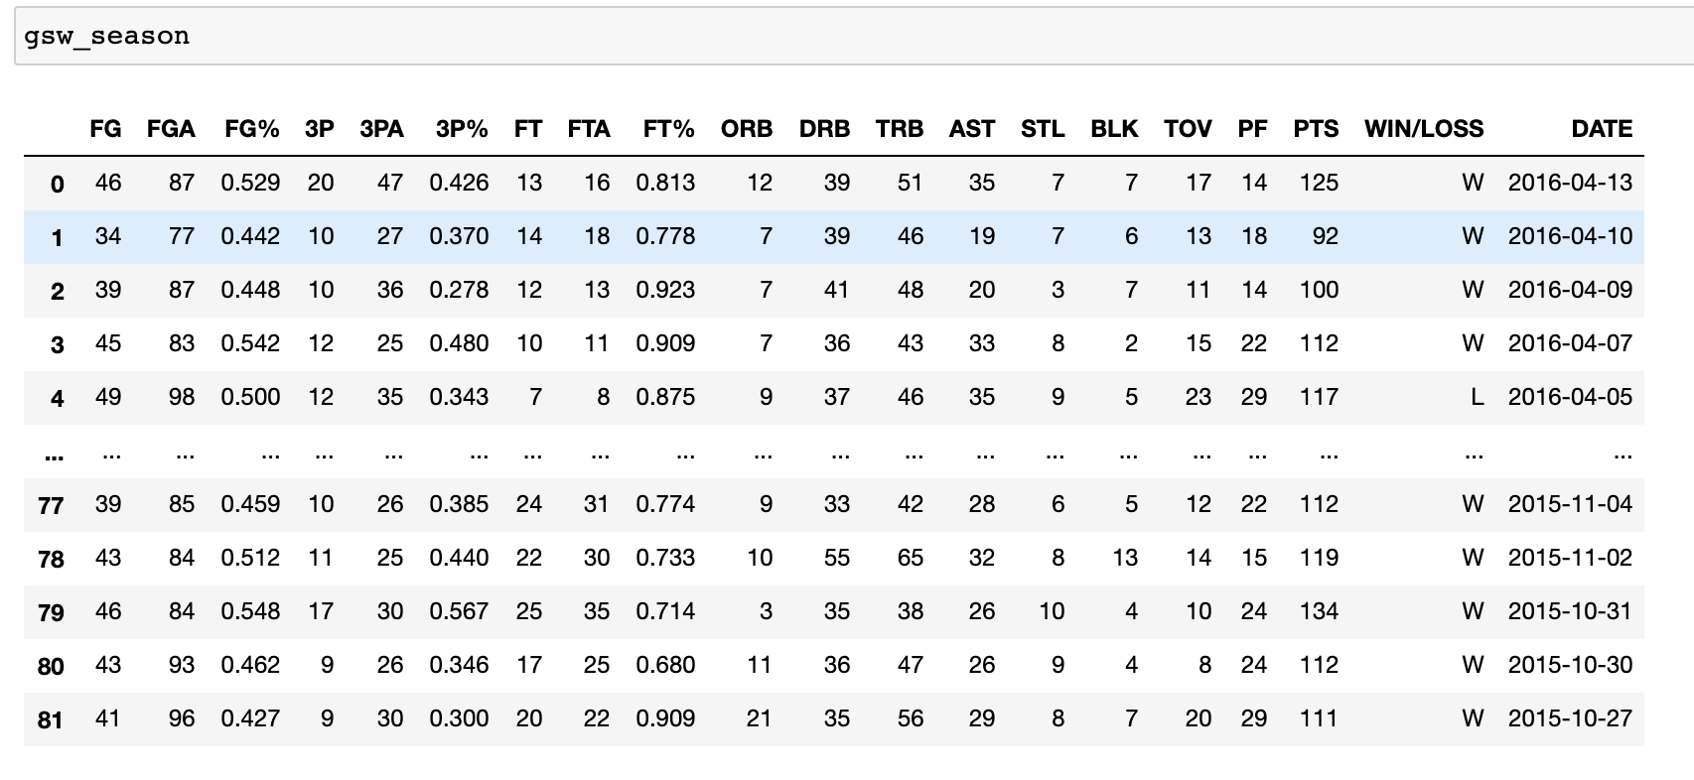
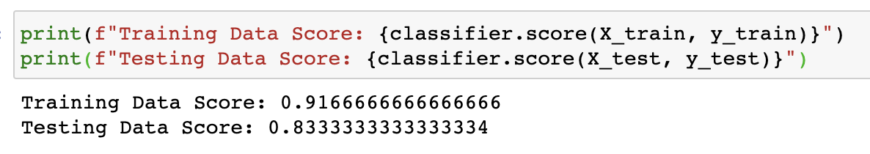
Analyzing a team’s performance with logistic regression
Four factors (from basketball reference):
Field Goal %
Turnovers
Rebounds
FTA/FGA ratio
Is it possible to predict if a team won/lost, given how that team played that day?
([team x] ⇒ [results y]) ⇒ win/loss

Slide 9
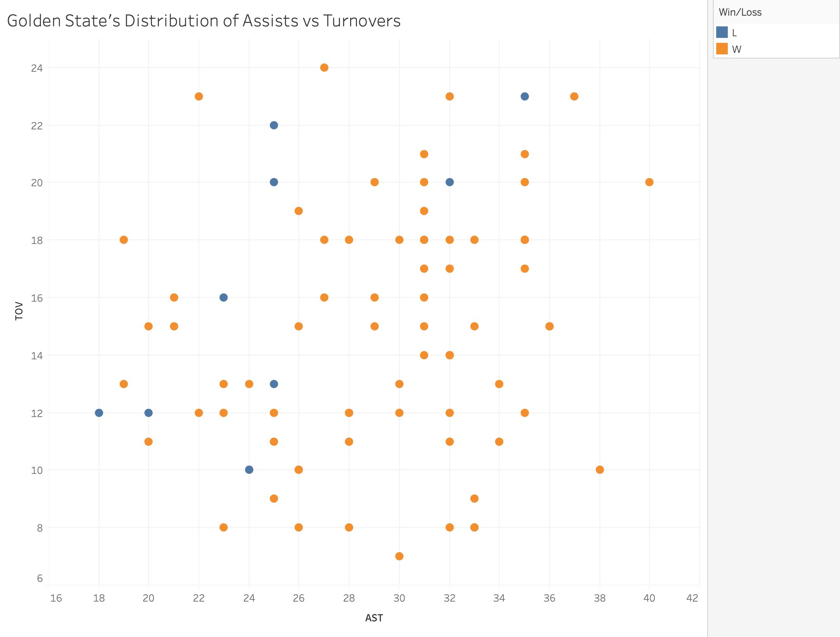
Things to Keep in Mind
Not all teams in the NBA are built equally
Tangibles/intangibles in competitive settings
Some factors weigh more for some teams over others
As helpful as analytics matter, basketball is still about points

Slide 10
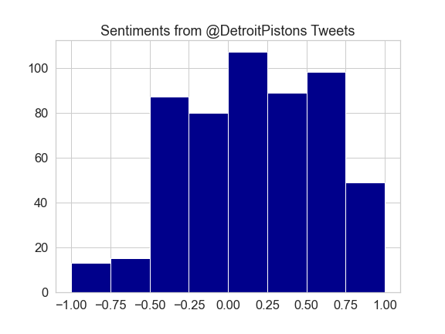
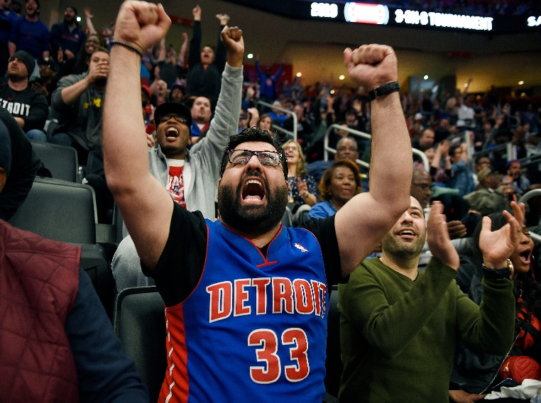
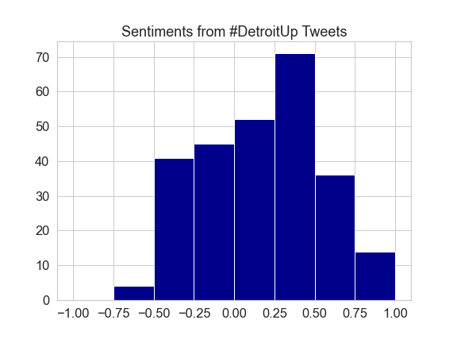
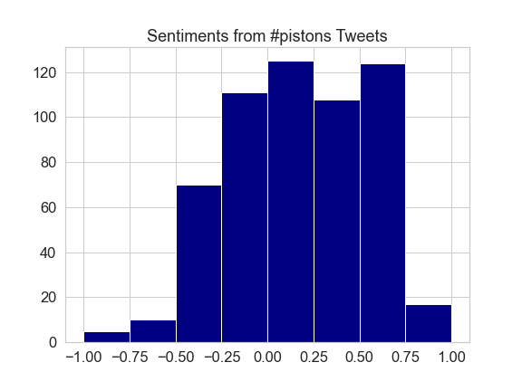
Sentiment Analysis and Team Performance
Can fan sentiment be used to determine a team’s performance?

Slide 11
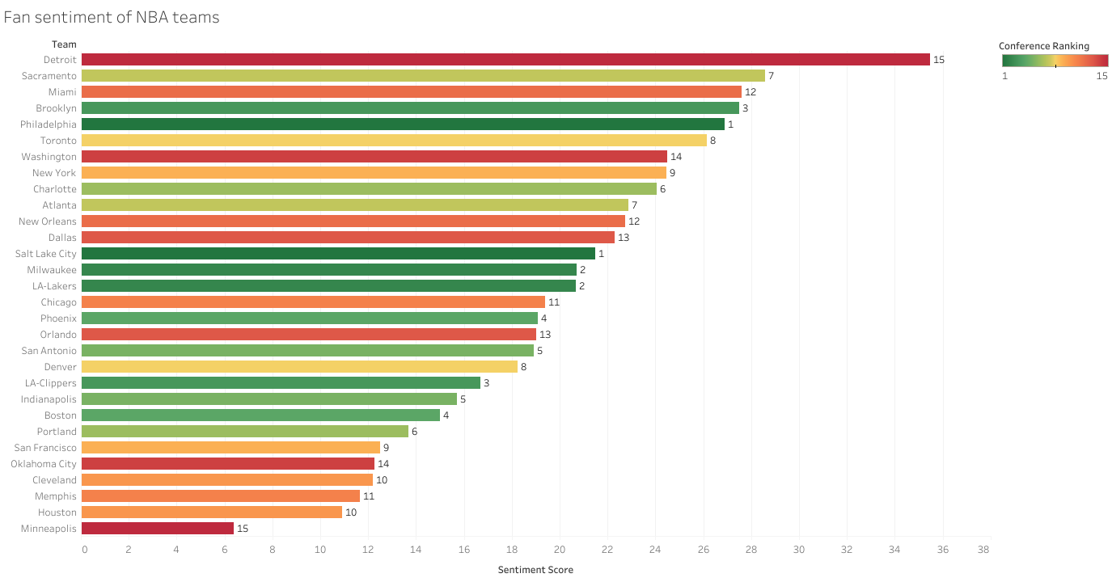
Fan Sentiment vs Team Conference Standings
Twitters API was used with TweePy and Textblob to evaluate each teams' hashtags, team account, and unique emoji to pull and analyze the current sentiment.
The highest and lowest sentiment values include the two worst teams in the league.
Along with being used predictively, this type of analysis could also be used by the team for other types of analysis. These could include how sentiment drives ticket and merchandise sales, or how effective marketing campaigns have been.

Slide 12
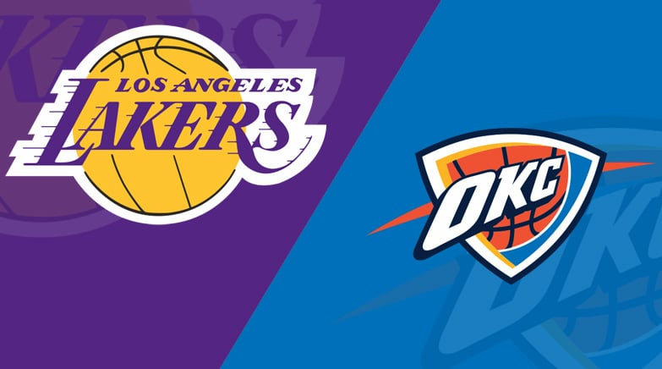
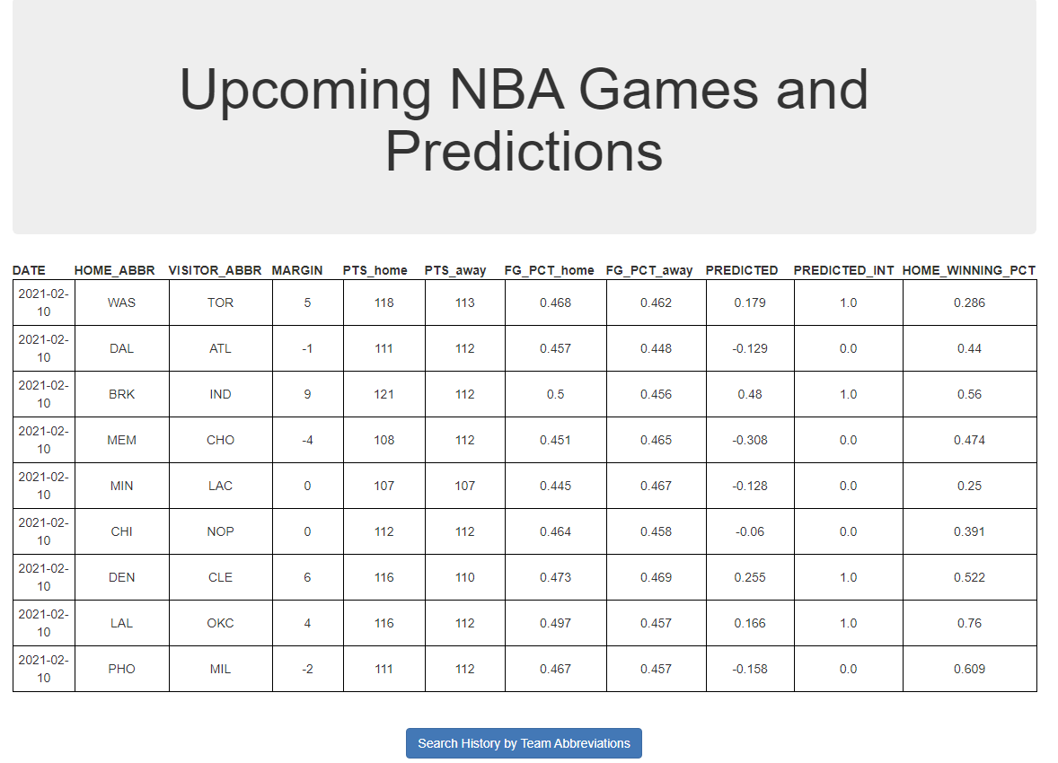
Predicting the Result Based on Previous Games
Can we correctly predict the outcome of a game based on the team's previous games?

Slide 13
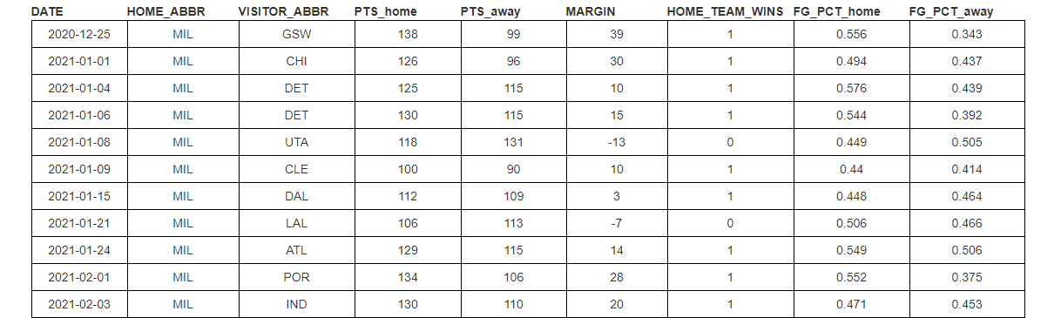


Predicting the Results of Tonight's Games
Scraped Basketball Reference season data and ran it through a machine learning algorithm.
After training the model, ran predictions against upcoming games
Teams that had a winning record and that the model predicted to win had an 83% accuracy score.

Slide 14
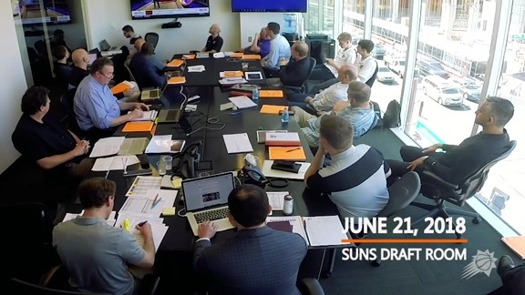
Continuing the Mission and Going Open Source
We have decided as a group that there are many more things we would like to explore using what we have already created, and expand on things that were cut due to time restraints.
Open source projects are an important when developing a portfolio and will contribute to furthering our skills beyond this course.
We are also open to having other members of the course become contributors, or if they know anyone interested in data analytics and basketball, to let them know we are open to welcoming them as well.

Slide 15
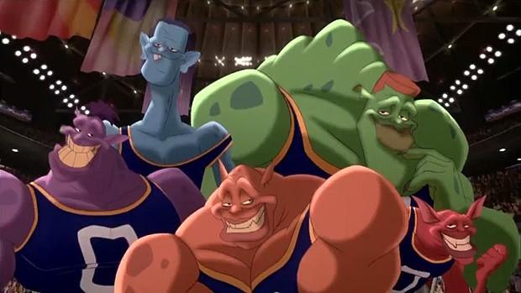
Thanks for Coming. Now, Take Us to Your Leader!

